Slide 1

C++ Programming
Day 4

Slide 2
Contents
· Object Oriented Programming Paradigms with C++
· Inheritance and access specifiers
· Overloading and overriding concepts
· Abstract Classes and virtual functions
· Logical Programming (Exercises)

Slide 3
· Introduction to C++
C++ is a middle-level programming language developed by Bjarne Stroustrup starting in 1979 at Bell Labs. C++ runs on a variety of platforms, such as Windows, Mac OS, and the various versions of UNIX

Slide 4
Difference between c and C++
C | C++
C contains 32 keywords. | C++ contains 63 keywords.
Not object Oriented | Object Oriented
C is a subset of C++ | Every C Program is a C++ program
Overloading not supported | Supports overloading

Slide 5
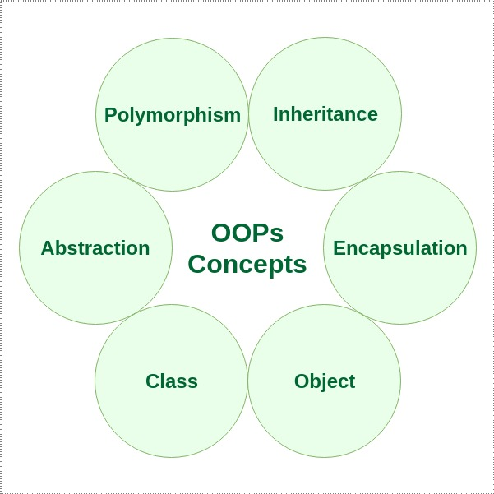
Object Oriented Programming Paradigms with C++

Slide 6
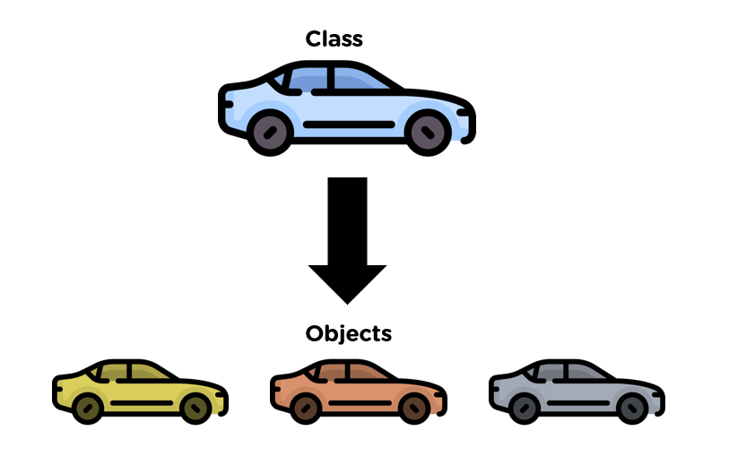
Object Oriented Programming Paradigms with C++
Object
Any entity that has state and behavior is known as an object. For example: chair, pen, table, keyboard, bike etc. It can be physical and logical.
Class
Collection of objects is called class. It is a logical entity.

Slide 7
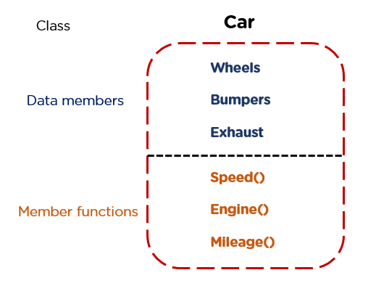
Object Oriented Programming Paradigms with C++
class Car
{
int Wheels;
string Bumpers;
int Exhaust
public:
void Speed(){}
void Engine(){}
void Mileage(){}
};
int main()
{
Car c1; // c1 is a object
}

Slide 8
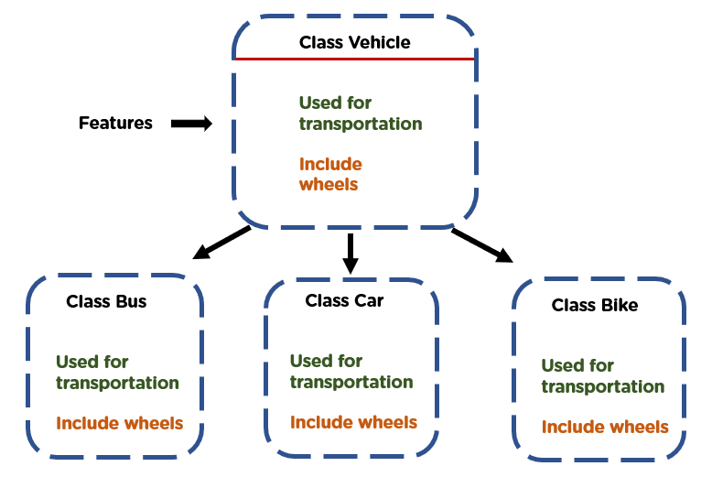
Inheritance and access specifies
When one object acquires all the properties and behaviors of parent object i.e. known as inheritance. It provides code reusability

Slide 9
Inheritance and access specifies
class Vehicle
{
int wheels;
int passengers;
public:
void set_wheels(int num) {
wheels = num;
}
int get_wheels() {
return wheels;
}
void set_pass(int num) {
passengers = num;
}
int get_pass() {
return passengers;
}
};
class truck : public Vehicle {
int cargo;
public:
void set_cargo(int size) {
cargo = size;
}
int get_cargo() {
return cargo;
}
void show();
};

Slide 10
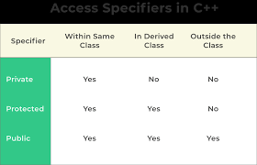
Inheritance and access specifies
There are 3 types of access modifiers available in C++:
Public
Private
Protected

Slide 11
Function Overloading
Function Overloading
Functions having the same name but different parameters is called Function Overloading.
For example:
sum( int a, float b)
sum(int a, int b)
sum(int a, int b, int c)

Slide 12
Function Overloading
include <iostream>
using namespace std;
class Addition {
public:
int add(int n1,int n2) {
return n1+n2;
}
int add(int n1,int n2,int n3) {
return n1+n2+n3;
}
};
int main(void) {
Addition a;
cout<<a.add(20, 15)<<endl;
cout<<a.add(81, 162,21);
return 0;
}

Slide 13
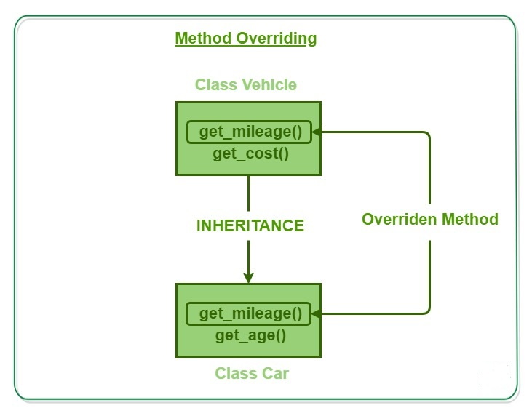
Function Overriding
Function Overriding
When a derived class has a function with the same name as a function of the base class, it is called Function Overriding.

Slide 14
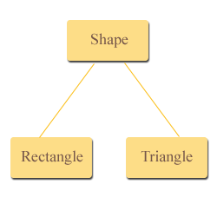
Abstract Class
An abstract class is a class that contains at least one pure virtual function.
Abstract classes cannot be instantiated

Slide 15
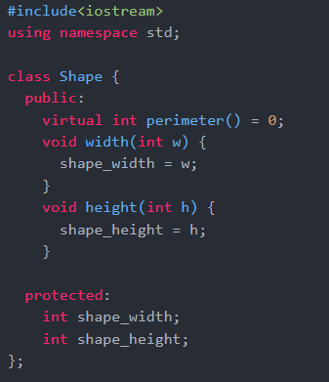
Abstract Class

Slide 16
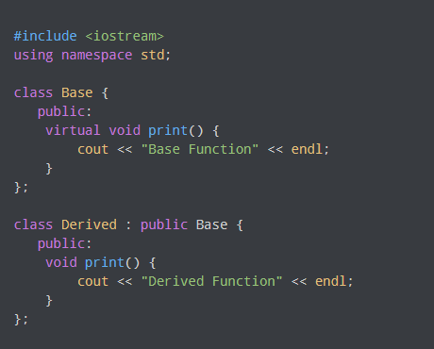
Virtual Funtions
A virtual function is a member function which is declared within a base class and is re-defined (overridden) by a derived class
A pure virtual function in C++, also known as the do-nothing function, is a virtual function that does not perform any task

Slide 17
Virtual Funtions
A virtual function is a member function which is declared within a base class and is re-defined (overridden) by a derived class
A pure virtual function in C++, also known as the do-nothing function, is a virtual function that does not perform any task

Slide 18

Please contact
Foundation for Innovation and Collaborative
Education
mentor@fice.in
www.fice.in
Please contact
Foundation for Innovation and Collaborative
Education
info@fice.in
mentor@fice.in
Notes:
Here are the lessons we are going to learn today.

